Slide 1
Data 604: Apache Spark
Team Members:
Bill Spackman
Gerwin Seier
Abayomi Adekoya
Yuyao Chen

Slide 2
Our Research Objective
There has been such a rapid development in processing power of computers and information gathering in the last three decades. Corporate systems are constantly on the look out for talents, machines and software that can treat the vast data collected.
The objective of our research is to examine the available technology and their application in processing large data set.
We would be studying the capabilities of Apache Spark and how it can use in practice.

Slide 3

What is Apache Spark
Apache Spark is a unified analytics engine for large-scale data processing.
Speed: Run workloads 100x faster.
Ease of Use: Write applications quickly in Java, Scala, Python, R, and SQL.
Generality: Combine SQL, streaming, and complex analytics.
Runs Everywhere: Spark runs on Hadoop, Apache Mesos, Kubernetes, standalone, or in the cloud. It can access diverse data sources.[1]
Image from [1]

Slide 4
History of Spark
Spark was initially started by Matei Zaharia at UC Berkeley's AMPLab in 2009, and open sourced in 2010 under a BSD license.[2]
In 2013, the project was donated to the Apache Software Foundation and switched its license to Apache 2.0. In February 2014, Spark became a Top-Level Apache Project.[3]
In November 2014, Spark founder M. Zaharia's company Databricks set a new world record in large scale sorting using Spark.[4]

Slide 5
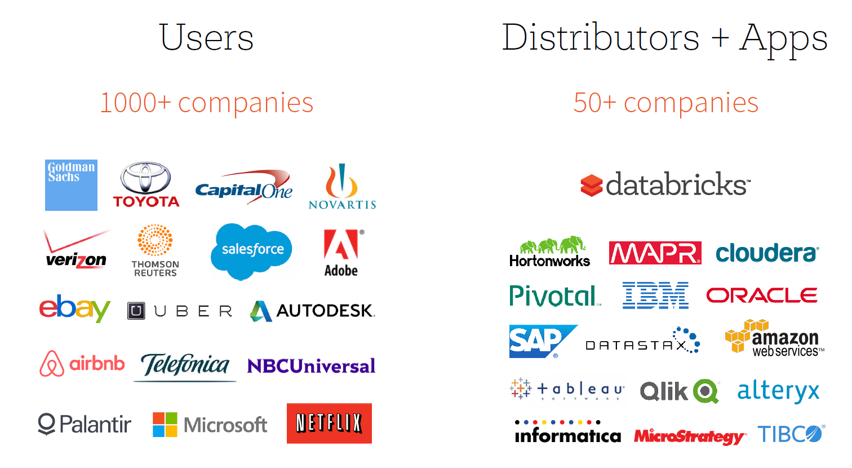
Image From Zaharia, M.: Spark 2.0. Presentation(2016) [6]
Spark had in excess of 1000 contributors in 2015 making it one of the most active projects in the Apache Software Foundation and one of the most active open source big data projects[5].

Slide 6
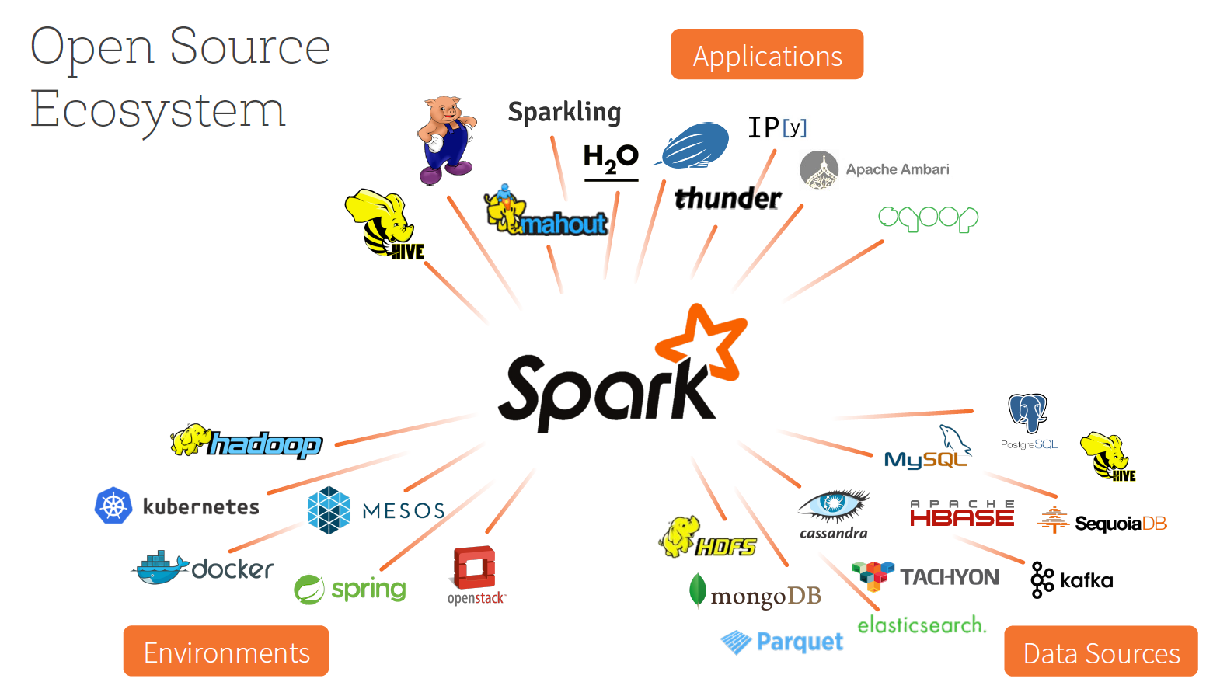
Image from Zaharia, M.: Spark 2.0. Presentation [7].

Slide 7
Why Apache Spark
This is a programming model that supports a much wider class of applications than MapReduce, while maintaining its automatic fault tolerance[1].
Process within the main memory of the worker nodes and prevent the unnecessary operations with the disk;
Pass and transform the task without writing on the disks and minimizing the number of read/write cycles to the disks.

Slide 8
Compare with Map-reduce
MapReduce is inefficient for multi-pass applications that require low-latency data sharing across multiple parallel operations. These applications are quite common in analytics, and include:
Iterative algorithms, including many machine learning algorithms and graph algorithms.
Interactive data mining, where a user would like to load data into RAM across a cluster and query it repeatedly.
Streaming applications that maintain aggregate state over time. [1]
Traditional MapReduce and DAG engines are suboptimal for these applications because they are based on acyclic data flow: an application has to run as a series of distinct jobs, each of which reads data from stable storage (e.g. a distributed file system) and writes it back to stable storage. They incur significant cost loading the data on each step and writing it back to replicated storage.[1]

Slide 9
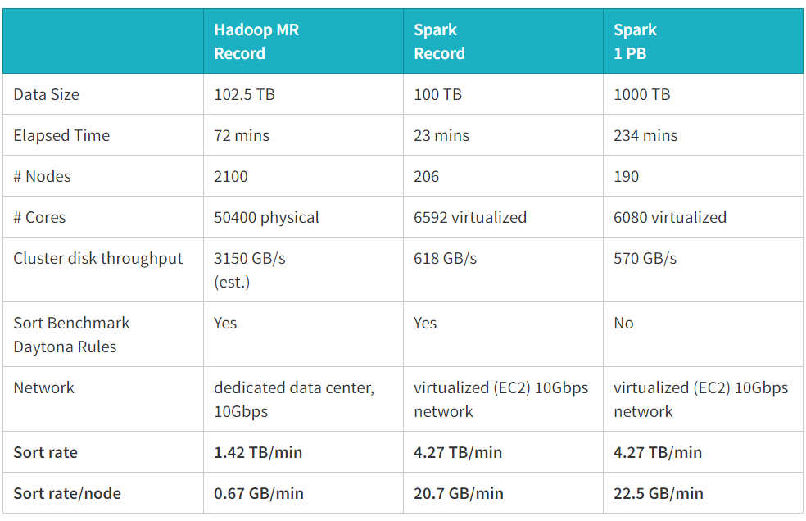
Speed comparison:
Spark sorted 100 TB of data on disk in 23 minutes. In comparison, the previous world record set by Hadoop MapReduce used 2100 machines and took 72 minutes. This means that Apache Spark sorted the same data 3X faster using 10X fewer machines. All the sorting took place on disk (HDFS), without using Spark’s in-memory cache. [9]
Image from reference [9]

Slide 10
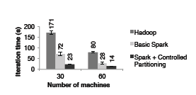
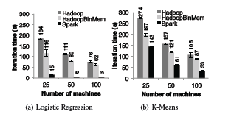
Fig.1 Performance of PageRank on Hadoop and Spark (images from [8])
Fig.2 Duration of the first and later iteration in Hadoop, HadoopBinmem and spark for Kmeans using 100GB of data on a 100 node cluster(images from [8])

Slide 11
Apache Spark - Main Components
Apache Spark system consists of several main components including Spark core [10,11,12] and upper-level libraries:
Spark’sMLlib for machine learning [13]
GraphX [14] for graph analysis
Spark Streaming [15] for stream processing
Spark SQL [16] for structured data processing
Apache Core
It can handle linear algebra, mathematical operations, machine learning, graphing, streaming data as a stand alone and in clusters. It can also interface Hadoop database system. See the overview of Apache Spark structure is next slide[17]
Cluster Managers
Under the hood, Spark is designed to efficiently scale up from one to many thousands of compute nodes. To achieve this while maximizing flexibility, Spark can run over a variety of cluster managers, including Hadoop YARN, Apache Mesos, and a simple cluster manager included in Spark itself called the Standalone Scheduler[8].
Storage Layers for Spark
Spark can create distributed datasets from any file stored in the Hadoop distributed file system (HDFS) or other storage systems supported by the Hadoop APIs (include‐ing your local file system, Amazon S3, Cassandra, Hive, HBase, etc.).
It’s important to remember that Spark does not require Hadoop; it simply has support for storage systems implementing the Hadoop APIs. [8]

Slide 12
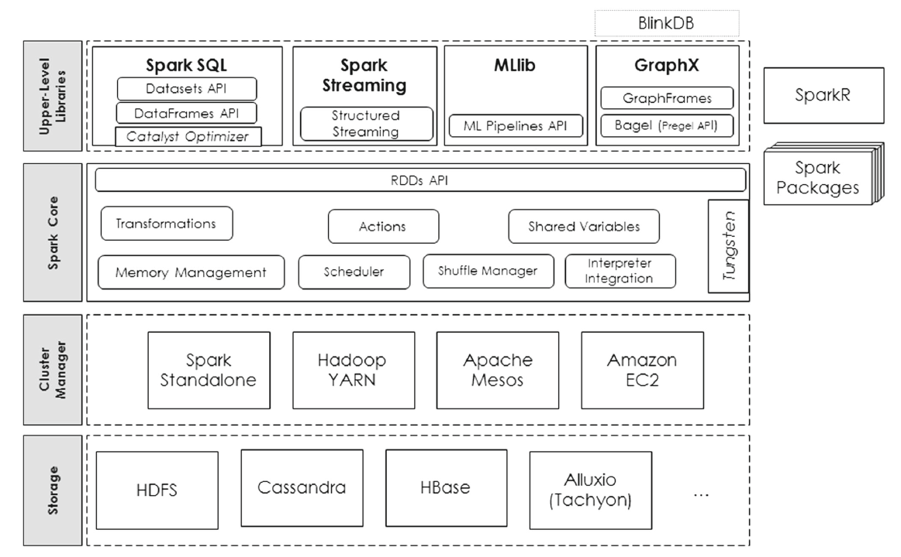
Apache Spark High Level Performance Architechture
Image from reference [17]
Notes:
[2] Salloum, Salman; Dautov, Ruslan; Chen, Xiaojun; Peng, Patrick Xiaogang; Huang, Joshua Zhexue;, "Big data analytics on Apache Spark," International Journal of Data Science and Analytics, no. DOI 10.1007/s41060-016-0027-9, p. 145–164, 13 October 2016.

Slide 13
RDD
RDD in Spark is simply an immutable distributed collection of objects. Each RDD is split into multiple partitions, which may be computed on different nodes of the cluster.
RDDs can be stored in memory between queries without requiring replication. Instead, they rebuild lost data on failure using lineage: each RDD remembers how it was built from other datasets (by transformations like map, join or groupBy to rebuild itself.
RDDs can contain any type of Python, Java, or Scala objects, including userdefined classes.
Users create RDDs in two ways: by loading an external dataset, or by distributing a collection of objects (e.g., a list or set) in their driver program. RDDs support two types of operations:
Transformations are operations on RDDs that return a new RDD, such as map() and filter().
Actions are operations that return a result to the driver program or write it to storage, and kick off a computation, such as count() and first(). [8]
Notes:
In fact, for the first() action, Spark scans the file only until it finds the first matching line; it doesn’t even read the whole file.
If you would like to reuse an RDD in multiple actions, you can ask Spark to persist it using RDD.persist(). We can ask Spark to persist our data in a number of different places,

Slide 14
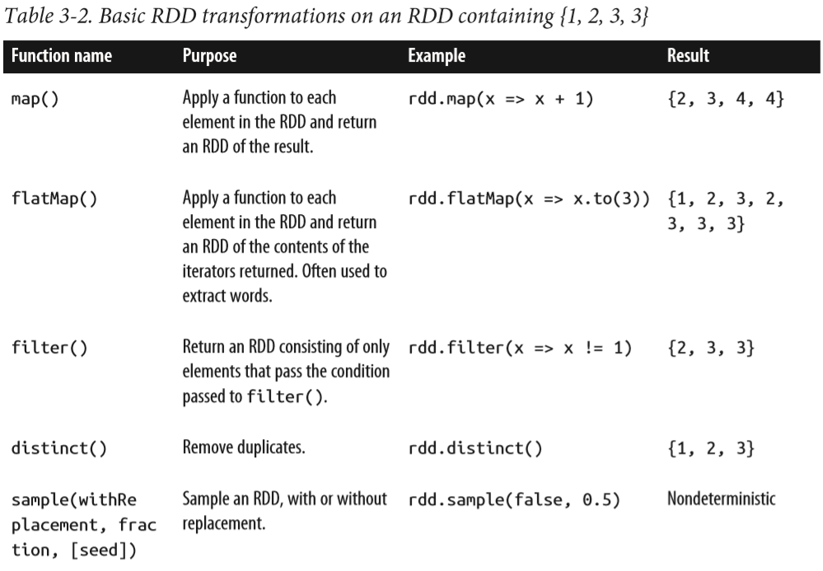
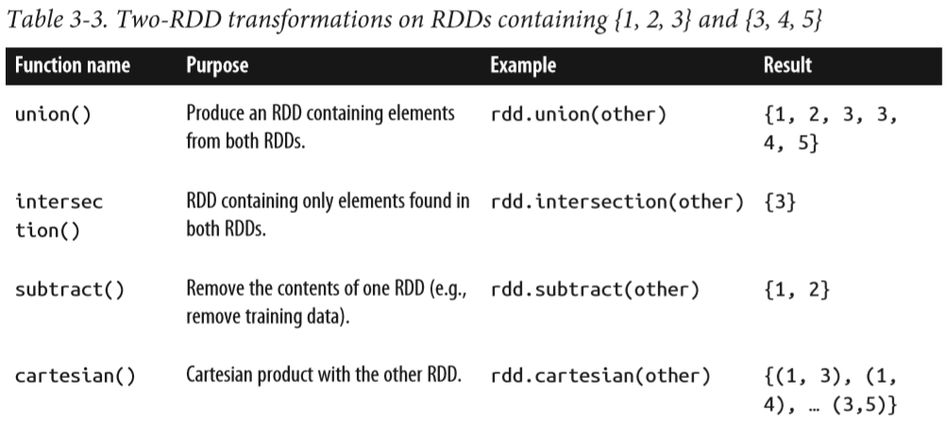
RDD Transformations
Transformations are operations on RDDs that return a new RDD.
Transformations use “Lazy Evaluation” i.e. transformed RDDs are computed lazily, only when you use them in an action. [8]
Images from: Learning Spark [8]
Notes:
Create some input RDDs from external data.
Transform them to define new RDDs using transformations like filter().
Ask Spark to persist() any intermediate RDDs that will need to be reused.
Launch actions such as count() and first() to kick off a parallel computation, which is then optimized and executed by Spark.
Lazy evaluation : Spark will not begin to execute until it sees an action.

Slide 15
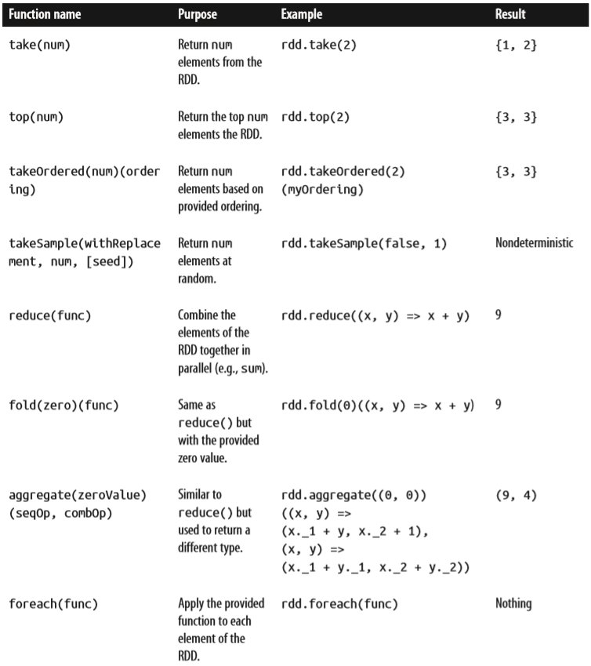
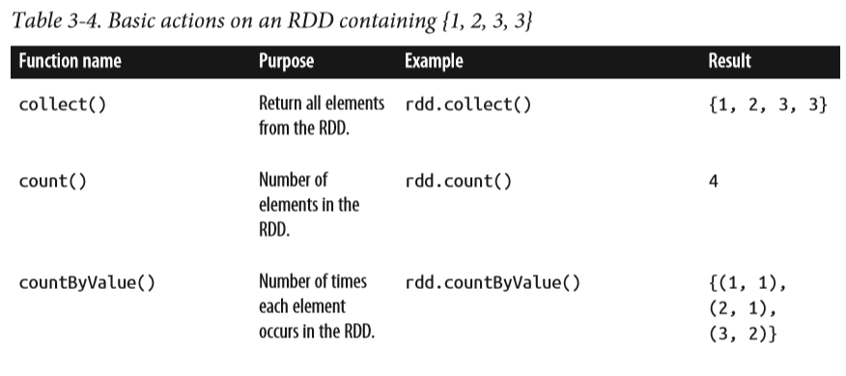
RDD Actions
They are the operations that return a final value to the driver program or write data to an external storage system.
Actions force the evaluation of the transformations required for the RDD they were called on, since they need to actually produce output. [8]
Images from: Learning Spark [8]
Notes:
Transformations are operations on RDDs that return a new RDD, such as map() and filter(). Actions are operations that return a result to the driver pro‐ gram or write it to storage, and kick off a computation, such as count() and first().
transformations return RDDs, whereas actions return some other data type.

Slide 16
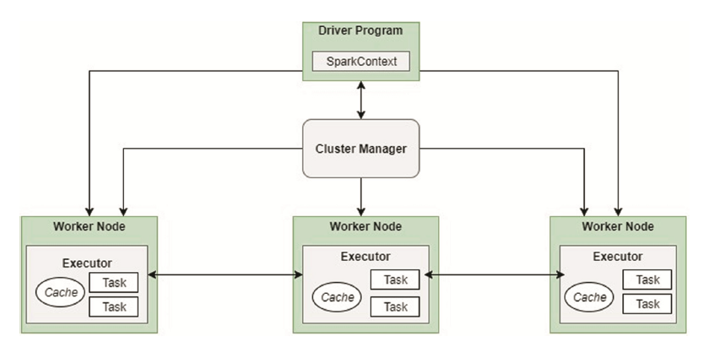
Architecture and work process
Image from reference [18]

Slide 17
Interactive Activity

Slide 18
Group Task #1 – Distribute and Execute
Count Cards
Node 1
Memory
Node 1
Result
Node 2
Memory
Node 2
Result
Collect & Write Back to Disk
Original Data on Disk
Node 3
Memory
Node 3
Result
Node 4
Memory
Node 4
Result
Master
Task
Log
Distribution
Task Execution
Return Result

Slide 19
Group Task #2 – Transform, & Execute
Remove Face Cards
Count Cards
Node 1
Memory
Node 1
Memory
Node 1
Result
Node 2
Memory
Node 2
Memory
Node 2
Result
Collect & Write Back to Disk
Node 3
Memory
Node 3
Memory
Node 3
Result
Node 4
Memory
Node 4
Memory
Node 4
Result
Transformation
Task Execution
Return Result
Master
Task
Log
Persistence

Slide 20
Group Task #3 – Persist, Transform, & Execute
Remove Face Cards
Remove Red Cards
Count Cards
Node 1
Memory
Node 1
Memory
Node 1
Memory
Node 1
Result
Node 2
Memory
Node 2
Memory
Node 2
Memory
Node 2
Result
Collect & Write Back to Disk
Node 3
Memory
Node 3
Memory
Node 3
Memory
Node 3
Result
Node 4
Memory
Node 4
Memory
Node 4
Memory
Node 4
Result
Transformation 1
Transformation 2
Master
Task
Log
Task Execution
Return Result
Persistence

Slide 21
Group Task #4 – Persist, Execute, Execute
Face & Red Cards Removed Already
Two Cards Back into Pile
Shuffle Pick Two Cards
Δ Card Value
Shuffle Pick Two Cards
Δ Card Value
Node 1
Memory
Node 1
Memory
Node 1
Result
Node 1
Memory
Node 1
Memory
Node 1
Result
Node 2
Memory
Node 2
Memory
Node 2
Result
Node 2
Memory
Node 2
Memory
Node 2
Result
Collect & Write Back to Disk
Collect & Write Back to Disk
Node 3
Memory
Node 3
Memory
Node 3
Result
Node 3
Memory
Node 3
Memory
Node 3
Result
Node 4
Memory
Node 4
Memory
Node 4
Result
Node 4
Memory
Node 4
Memory
Node 4
Result
Transformation 1
Transformation 1
Task Execution
Return Result
Task Execution
Return Result
Persistence
Persistence

Slide 22
Group Task #5 – Failure, Recover, Execute
Remove Face Cards
Remove Red Cards
Count Cards
Node 1
Memory
Node 1
Memory
Node 1
Memory
Node 1
Result
Node 2
Memory
Node 2
Memory
Node 2
Memory
Node 2
Result
Collect & Write Back to Disk
Node 3
Memory
Node 3
Memory
Node 3
Memory
Node 3
Result
Node 4 Failure!
Node 4
Memory
Node 4
Memory
Node 4
Memory
Node 4
Result
Transformation 1
Transformation 2
Master
Task
Log
Task Execution
Return Result
Persistence

Slide 23
Group Task #5 – Failure, Recover, Execute (cont’d)
Re-Distribute Data From Failed Node
Execute Lineage Tasks Stored in Master Log
Data Set Whole Again
Original Data on Disk
Collect & Write Back to Disk
Remove Face Cards
Remove Red Cards
Count Cards
Node 5
Memory
Node 5
Memory
Node 5
Memory
Node 5
Result
Transformation 1
Transformation 2
Master
Task
Log
Distribution
Task Execution
Return Result

Slide 24
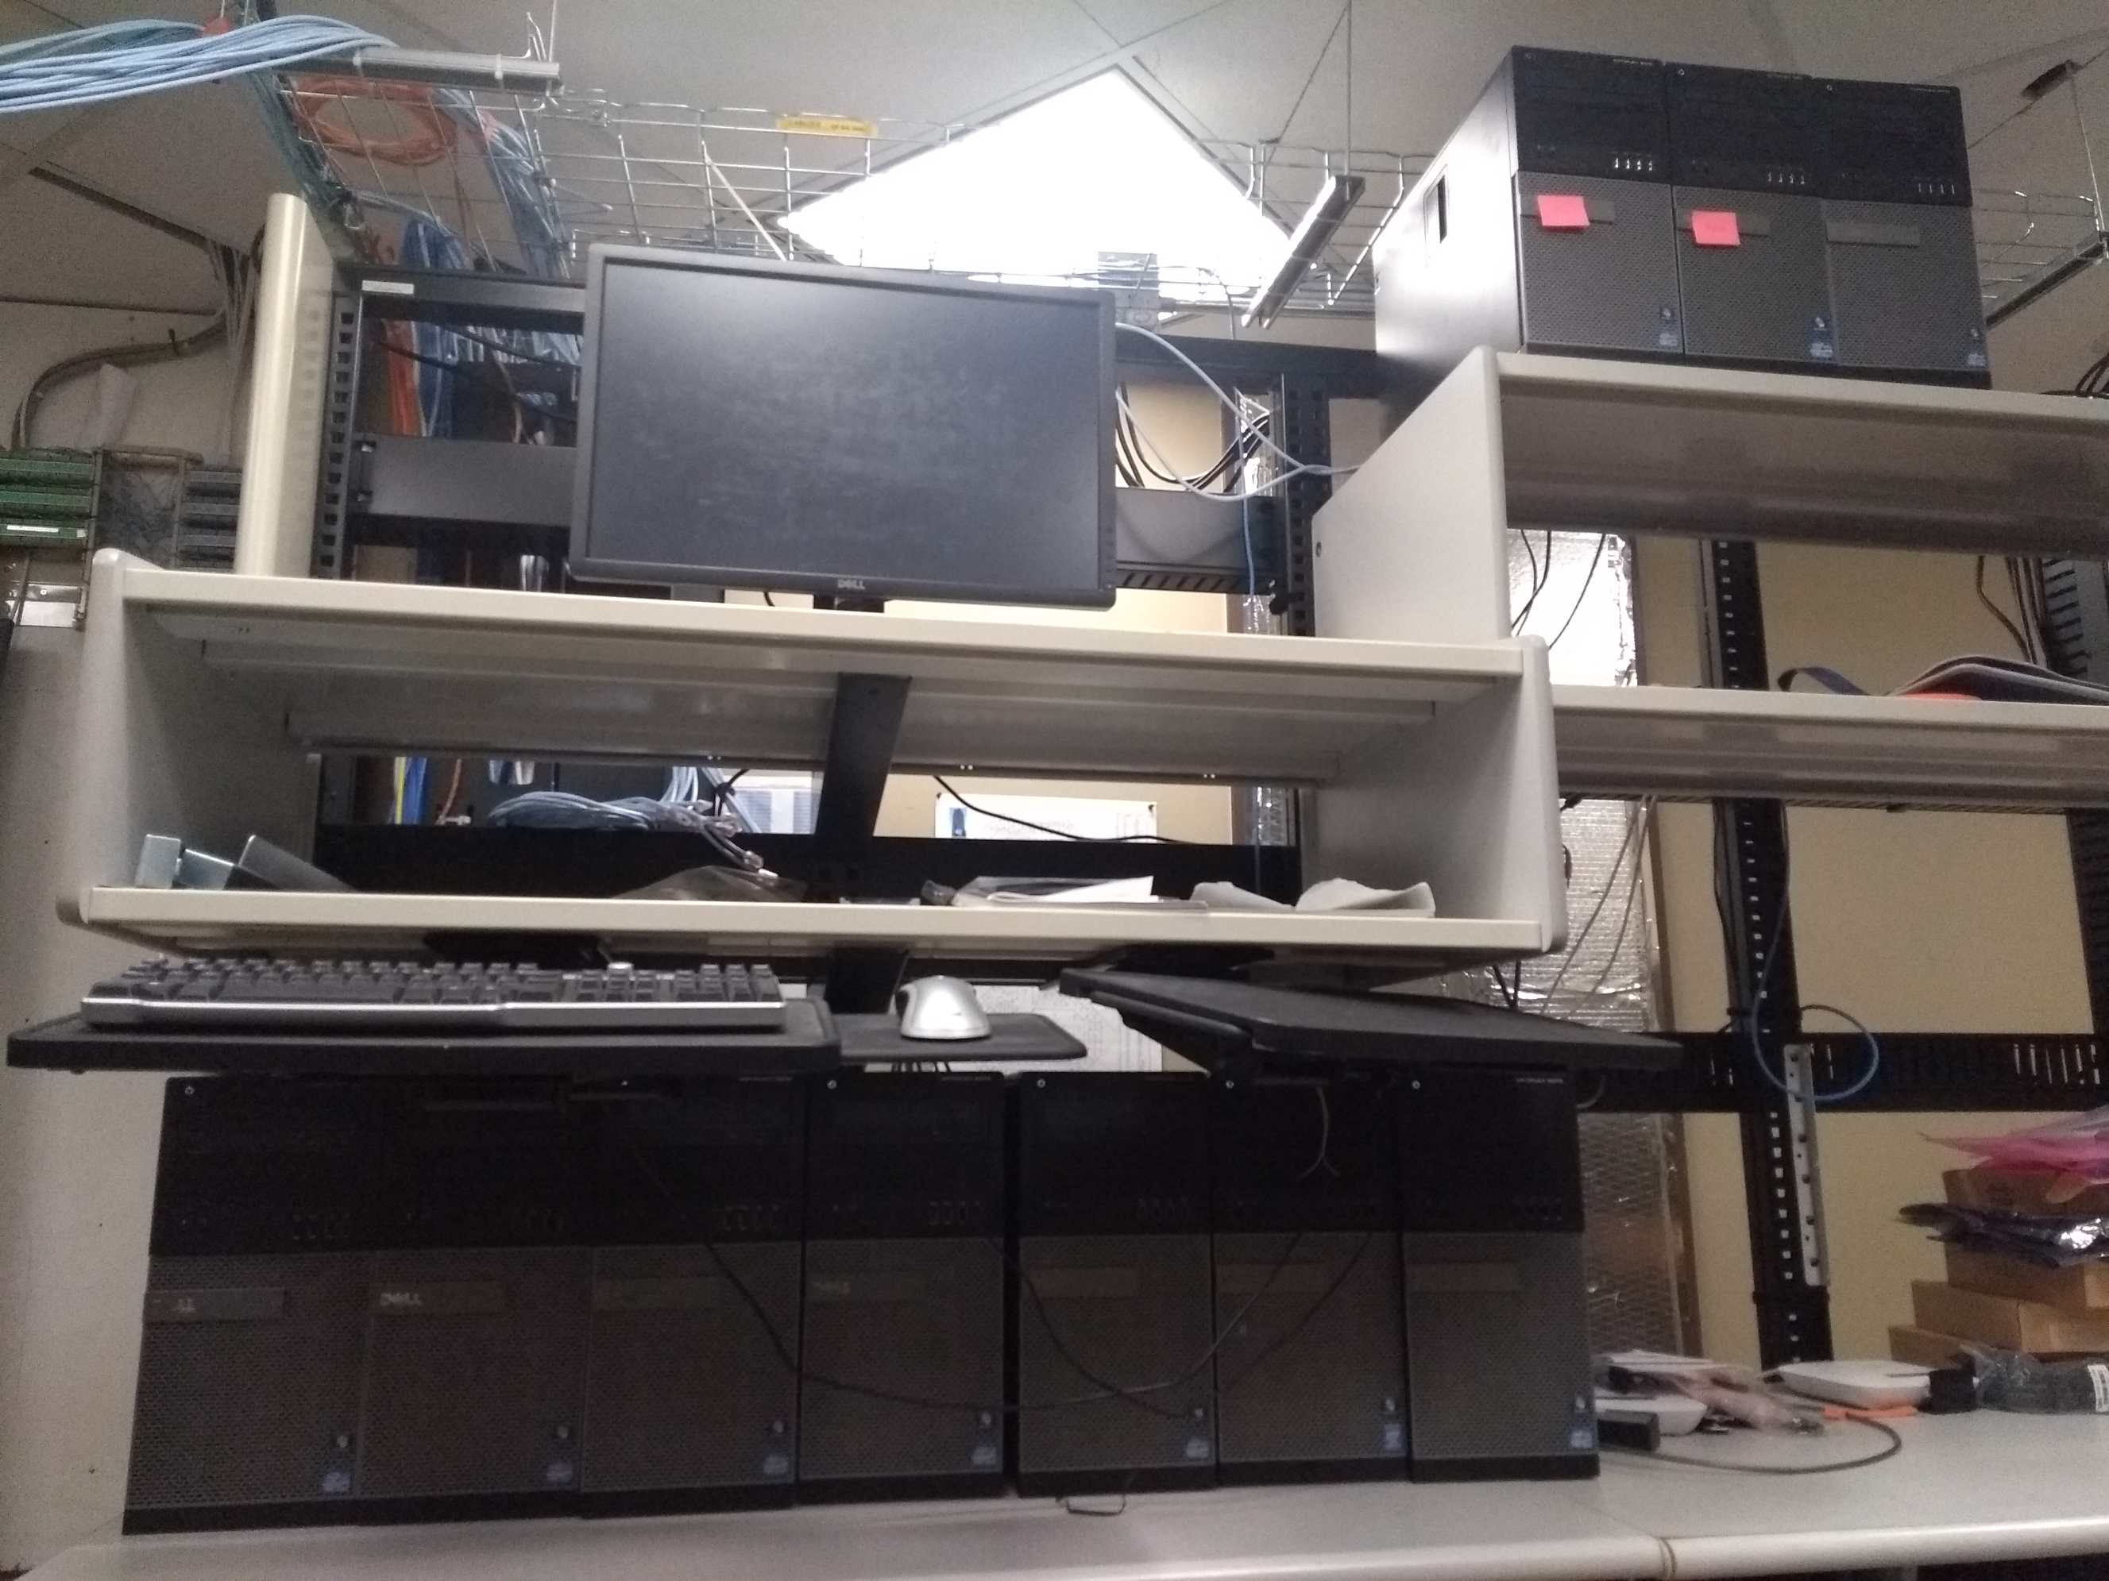
Demonstration

Slide 25
Spark Cluster Details
Master-Node Name: spark-master Client-Node Name: spark-client Slave-Node Name: spark-slave## Template Name: spark-template Client-Node IP : 192.168.111.1 Master-Node IP: 192.168.111.10 Cluster Starting IP: 192.168.111.101 Spark-template IP: 192.168.111.50 Cluster Gateway: 192.168.111.250 DNS: 192.168.200.9 HDFS hdfs://192.168.111.10:8020 Hadoop Cluster 192.168.111.10:9870 Hadoop Jobs 192.168.111.10:8088 Spark Cluster 192.168.111.10:8080 Spark Jobs 192.168.111.10:4040 RStudio 192.168.111.1.8787 Shiny Server 192.168.111.1:3838 Hadoop install dir: /usr/local/hadoop Spark install dir: /usr/local/spark JAVA install dir: /usr/lib/jvm/java-8-oracle Hive Install dir : /usr/local/hive ’conda install dir: /usr/local/anaconda Sqoop install dir: /usr/local/sqoop
Cluster configuration details:
Dell OptiPlex 9010 desktops with the following configuration.
Corei7 – 8 core processors @ 3.4GHz
12GB RAM
500GB HDD

Slide 26

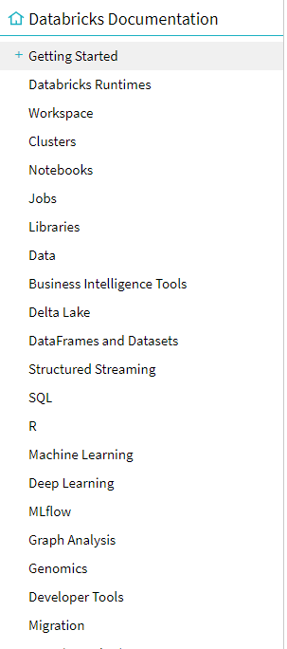
Spark Tutorial Platform
Databrick which is free version of Apache Spark tutorials on cloud platform, access by :
databrick.com/ce [19]

Slide 27
References
1. Apache Spark web: https://spark.apache.org/
2. Clark, Lindsay. "Apache Spark speeds up big data decision-making". ComputerWeekly.com. Retrieved 2018-05-16.
3."The Apache Software Foundation Announces Apache&#8482 Spark&#8482 as a Top-Level Project". apache.org. Apache Software Foundation. 27 February 2014. Retrieved 4 March 2014.
4. Spark officially sets a new record in large-scale sorting
5. Open HUB Spark development activity
6. Image From Zaharia, M.: Spark 2.0. Presentation.http://www.slideshare.net/da tabricks/2016-spark-summit-east-keynote-matei-zaharia (2016)
7. Zaharia, M.: Spark 2.0. Presentation. http://www.slideshare.net/databricks/2016-spark-summit-east-keynote-matei-zaharia (2016)
8. Karau, H., Konwinski, A., Wendell, P., & Zaharia, M. (2015). Learning spark: lightning-fast big data analysis. " O'Reilly Media, Inc.".
9.Spark officially sets a new record in large-scale sorting: https://databricks.com/blog/2014/11/05/spark-officially-sets-a-new-record-in-large-scale-sorting.html
10. Zaharia, M.: An Architecture for Fast and General Data Processing on Large Clusters. Association for Computing Machinery, New York, NY, USA (2016)
11. Zaharia, M., Chowdhury, M., Franklin, M.J., Shenker, S., Stoica, I.: Spark: cluster computing with working sets p 10. http://dl.acm.org/citation.cfm?id=1863103.1863113 (2010)
12. Zaharia, M., Chowdhury, M., Das, T., Dave, A.: Resilient distributed datasets: a fault-tolerant abstraction for in-memory cluster computing. NSDI’12 Proceedings of the 9th USENIX conference on Networked Systems Design and Implementation pp. 2–2. doi:10. 1111/j.1095-8649.2005.00662.x (2012)
13. Meng, X., Bradley, J., Yavuz, B., Sparks, E., Venkataraman, S., Liu, D., Freeman, J., Tsai, D., Amde, M., Owen, S., Xin, D., Xin,
R., Franklin, M.J., Zadeh, R., Zaharia, M., Talwalkar, A.: Mllib: Machine learning in apache spark arxiv:1505.06807 (2015)
14. Xin, R.S., Crankshaw, D., Dave, A., Gonzalez, J.E., Franklin,M.J., Stoica, I.: Graphx: Unifying data-parallel and graph-parallel analytics. CoRR arxiv:1402.2394 (2014)
15. Zaharia, M., Das, T., Li, H., Hunter, T., Shenker, S., Stoica, I.: Discretized streams: fault-tolerant streaming computation at scale. In: Proceedings of the Twenty-Fourth ACMSymposium on Operating Systems Principles, ACM, New York, NY, USA, SOSP ’13, pp. 423–438. doi:10.1145/2517349.2522737 (2013)
16. Armbrust, M., Ghodsi, A., Zaharia, M., Xin, R.S., Lian, C.,Huai, Y., Liu, D., Bradley, J.K., Meng, X., Kaftan, T., Franklin, M.J.: Spark SQL. In: Proceedings of the 2015 ACM SIGMOD International Conference on Management of Data—SIGMOD ’15, ACM Press, New York, NY, USA, pp. 1383–1394. doi:10.1145/2723372.2742797. http://dl.acm.org/citation.cfm?id=2723372.2742797 (2015)
17. Salloum, Salman; Dautov, Ruslan; Chen, Xiaojun; Peng, Patrick Xiaogang; Huang, Joshua Zhexue;, "Big data analytics on Apache Spark," International Journal of Data Science and Analytics, no. DOI 10.1007/s41060-016-0027-9, p. 145–164, 13 October 2016.
18. G. Mogha, K. Ahlawat and A. P. Singh, "Performance Analysis of Machine Learning Techniques on Big Data Using Apache Spark," in 4th International Conference on Recent Developments in Science, Engineering and Technology, REDSET, Gurgaon, India, 2017.
19. Data brick, web, databrick.com/ce
20. Installation Instructions https://static.packt-cdn.com/downloads/InstallingSpark.pdf

